Slide 1
MAdBlock
Illegal Advertisement Block Solution
도야지조
15109306 : 고병산
15109323 : 김지환
15109367 : 정운성

Slide 2
OUR TEAM
Project Member
Project Manager
15109306 고병산
15109367 정운성
15109323 김지환

Slide 3
INDEX
What is our project?
What have we done?
01
04
Difference between existing program and ours
Difficulties in our project
02
05
How does it work?
What’s next?
03
06
Purpose, function etc.
Current status
Problem and Solution
Difference of AdBlock
OCR, OpenCV and
Machine Learning.
Improvement and Future plan

Slide 4
01
What is our project?

Slide 5
Our project
Necessity
Purpose
Function
Why?
Social issue
Block illegal Advertisement
No server Chrome Extension
OCR + Machine Learning

Slide 6
Necessity
사행산업 관련 도박문제 예방 및 관리 실태 -감사원
(사행성산업통합감독위원)

Slide 7
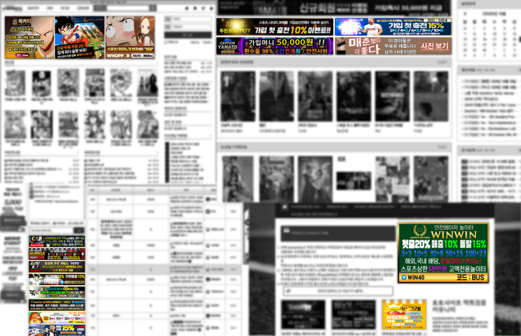
Too many illegal Advertisement

Slide 8
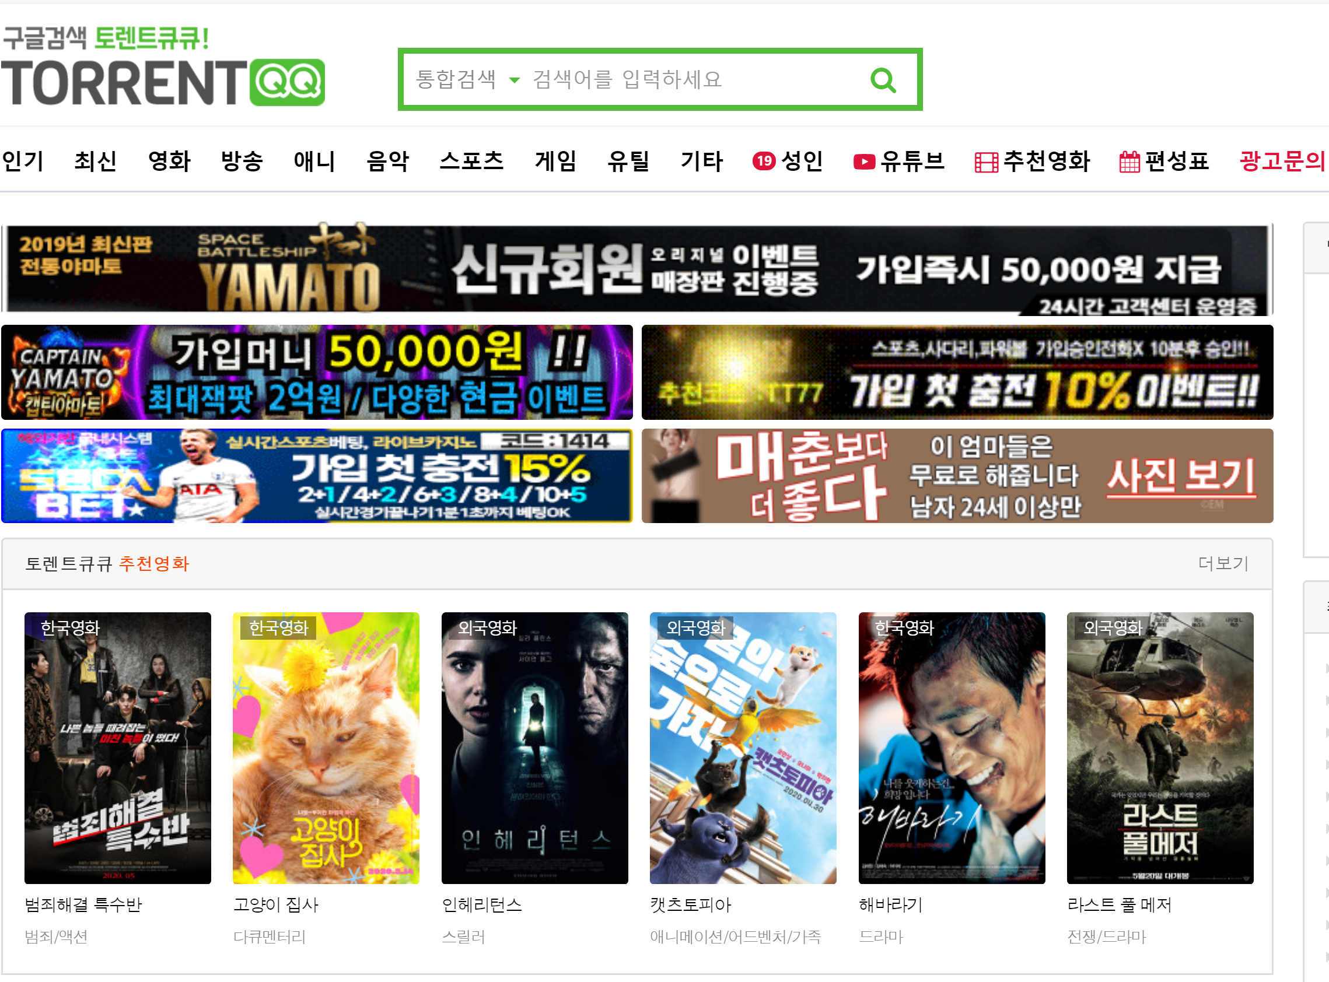
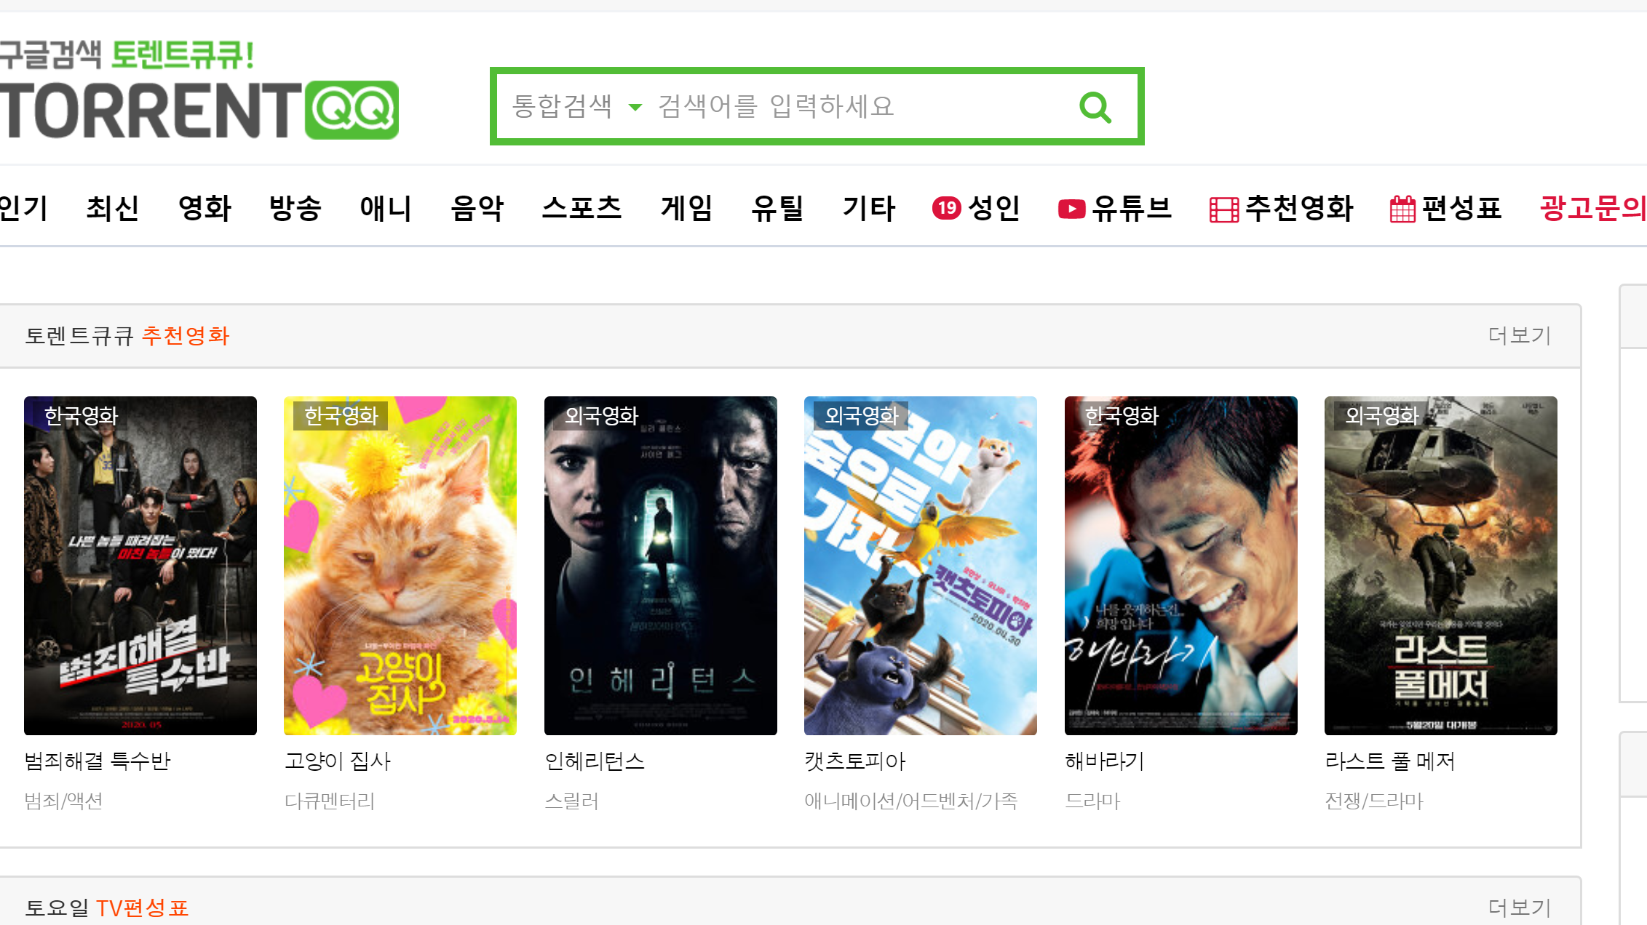
Purpose

Slide 9
Function
OCR
Tesseract OCR
OpenCV
Project
Linear Regression
ML
TensorFlow

Slide 10
No server
Extension
Takes long time to block
Too much Communication data
Convenience
Portability

Slide 11
02
Difference between existing program and ours

Slide 12
AdBlock
MAdBlock
■ Block using blacklist
■ Block ALL AD
■ Block using OCR
■ Block only illegal AD

Slide 13
03
How does it work?

Slide 14
Structure Factor
OpenCV
OCR
Machine Learning
Preprocessing
Extract keyword
Classify AD

Slide 15
OUR PROCESS
1
Javascript Worker execute on background
2
OpenCv for preprocessing
Classify advertisement by using Machine Learning
3
Tesseract OCR
Extract keyword
4
Distribute MAdBlock
5

Slide 16
04
What have we done?

Slide 17
Current Status
Block
Machine Learning
OCR
JavaScript Worker
Block illegal advertisement
Classify Advertisement
Recognition Character
Chrome Extension

Slide 18
05
Difficulties in our project

Slide 19
MISSION STATEMENT
CPU Usage
To provide result fast we are using local operation.
Due to budget problem, It’s hard to get good server.

Slide 20
Keyword recognize miss
OCR engine can’t provide precise keyword for instance it recognize word 토토 as 툐툐.

Slide 21
06
What’s next?

Slide 22
Current Status
Block
Machine Learning
OCR
JavaScript Worker
Block illegal advertisement
Classify Advertisement
Recognition Character
Chrome Extension

Slide 23
Future plan
Present
Machine Learning
Block
Test
OpenCV, OCR
Tensorflow.js
Erase Tag
Final Test

Slide 24
Thankyou

